Slide 1
High-Temperature Corrosion in CSP Systems
Payton Meade, Chemical engineering
a.m. Kannan, department of engineering, CTI
Arizona state university

Slide 2
What is CSP?
Concentrating Solar Power (CSP)
Not the same as the popular photovoltaic systems
Can produce energy after the sun goes down
Uses a field of mirrors to concentrate light to a point
Department of Energy (DOE) is currently funding the construction of many around the Southwest

Slide 3

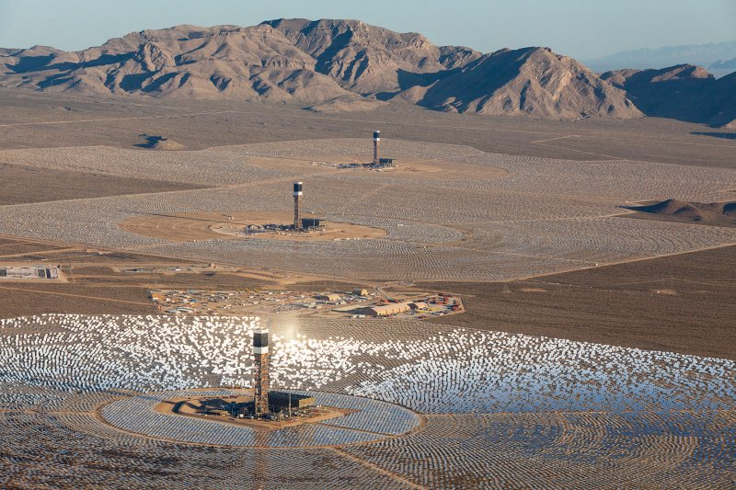
Various CSP Power Towers
[1], [2] Photos courtesy of: SolarReserve
Notes:
Crescent Dune Right/Ivanpah Left. Ivanpah is low impact. Uses 170K heliostats. Powers 140K Homes in S. Cal.

Slide 4
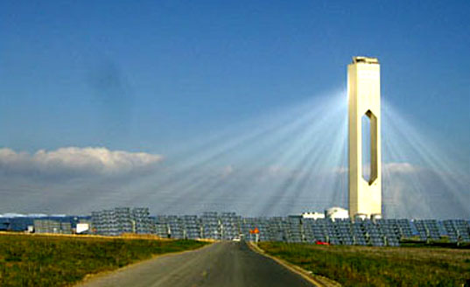
How It Works
Field of sun-tracking mirrors (heliostats) focus the light to a point on a receiver tower
Can track sun during summer and winter, when sun is at different angles to horizon
Temperatures over 1000 ºC
Salt at top of receiver is heated
Acts as a heat transfer fluid (HTF)
Carries energy and transfers to water
Property of HTFs: low melt point
[3] Photo courtesy of: inhabitat.com
Notes:
Explain what HTF is: carries energy and transfers to water (steam generator)
Properties of HTF (low melting point, stabile at high temps 1000, low corrosion piping)

Slide 5
How It Works (cont.)
Heated salt goes through heat exchanger to produce steam
Some of the heated salt is sent to a storage tank– produces energy after the sun goes down
Steam turbine generates electricity
Most recent plants built can produce
400 MW_{e} (~140K homes) during peak periods [Ivanpah]
110 MW_{e} (~75K homes) [Crescent Dunes]
Notes:
Ivanpah is largest in world with 3 power towers and 5 acres worth of heliostats
Crescent Dunes has one power tower

Slide 6
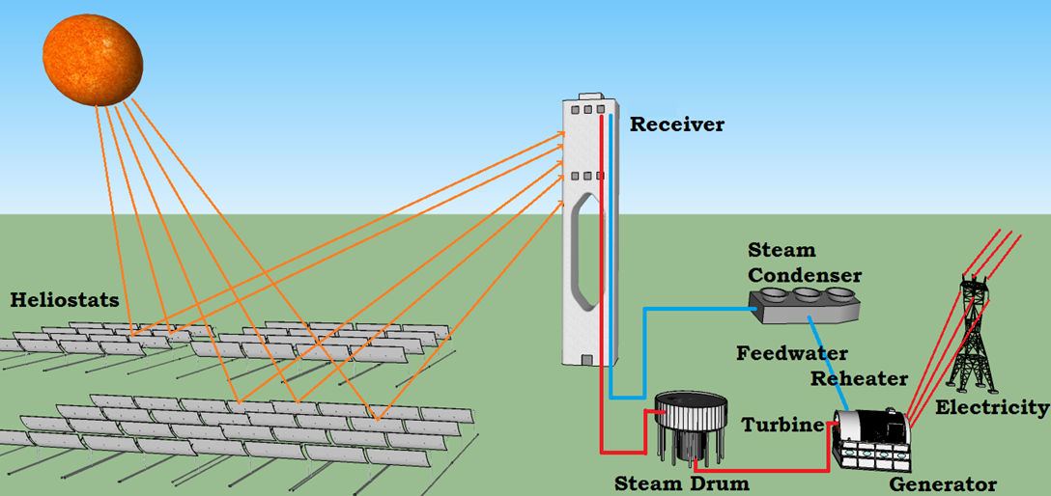
Schematic of a CSP System
[4] Photo courtesy of: ASU Polytechnic, CTI

Slide 7
Types of Heat Transfer Fluids
Nitrates currently used in CSP systems
Solar Salt is the specific mixture used in commercial CSP
40 wt% KNO₃ and 60 wt% NaNO₃
Eutectic mixture (lowest melting point)
Melting point: <200 ºC
Stays stabile up to ~550-600 ºC
First tested with Solar Two in the 1990s
Plants that use Solar Salt include Gemasolar and Crescent Dunes
Notes:
Eutectic—if the composition is changed at all, then the melting point will drastically change

Slide 8
Improving HTFs
New salts developed to combat previous problems
Combat freezing issues in pipes
Hitec Salt: tertiary mixture
7:53:40 wt% NaNO₃:KNO₃:NaNO₂
Lowered melting point: 142 ºC
Lowered melting point also means it does not stay as stabile at high temperatures
Stabile up to ~530 ºC

Slide 9
Objective
Study different salt compositions that could be used in CSP systems
Melting point under 250 ºC
Stabile at temperatures above 800 ºC
Low corrosion of SS and Nickel alloys
Costs less than $1/kg of salt

Slide 10
A New Molten Salt: Current Work
Multidisciplinary University Research Initiative (MURI)
ASU Polytechnic, Georgia Tech, University of Arizona
Funded by DOE under SunShot initiative
Reduce total installation costs of solar power by 2020
Goal of $0.06/kWh
New salt composed of NaCl, KCl, and ZnCl₂
Chlorides stabile at high temperatures and low in cost
Highly corrosive and high melting temperature

Slide 11
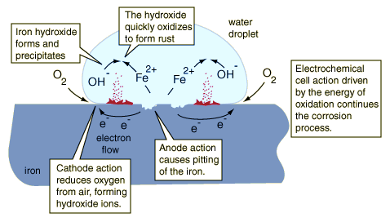
Corrosion Mechanism
Notes:
Destruction of metals by electrochemical reactions with the environment
Pulls moisture from air in case of chloride
Chloride more corrosive—more electronegative. It ionizes the metal more quickly, causes metals to react with water.

Slide 12
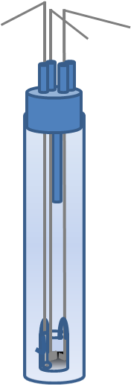
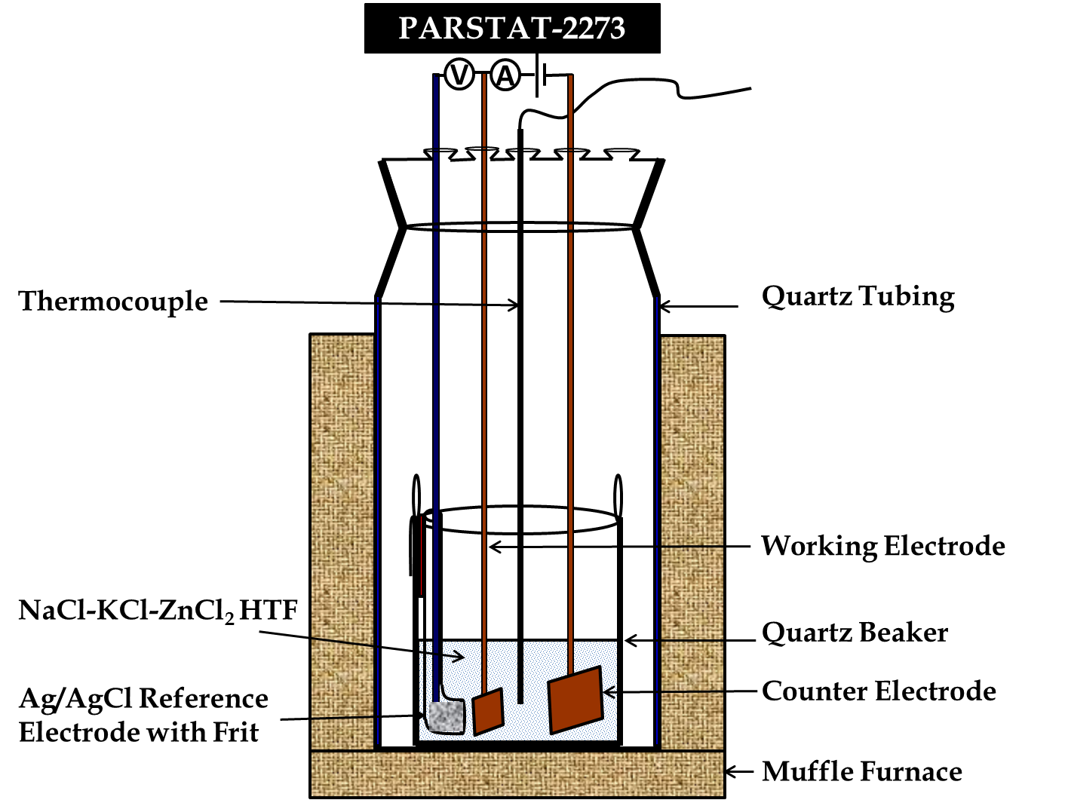
Corrosion Data Techniques
Thermocouple
log | I | vs E plot
482
log | I | →
- ←E→ +
Furnace
Advanced Electrochemical System
Argon Gas Cylinder

Slide 13
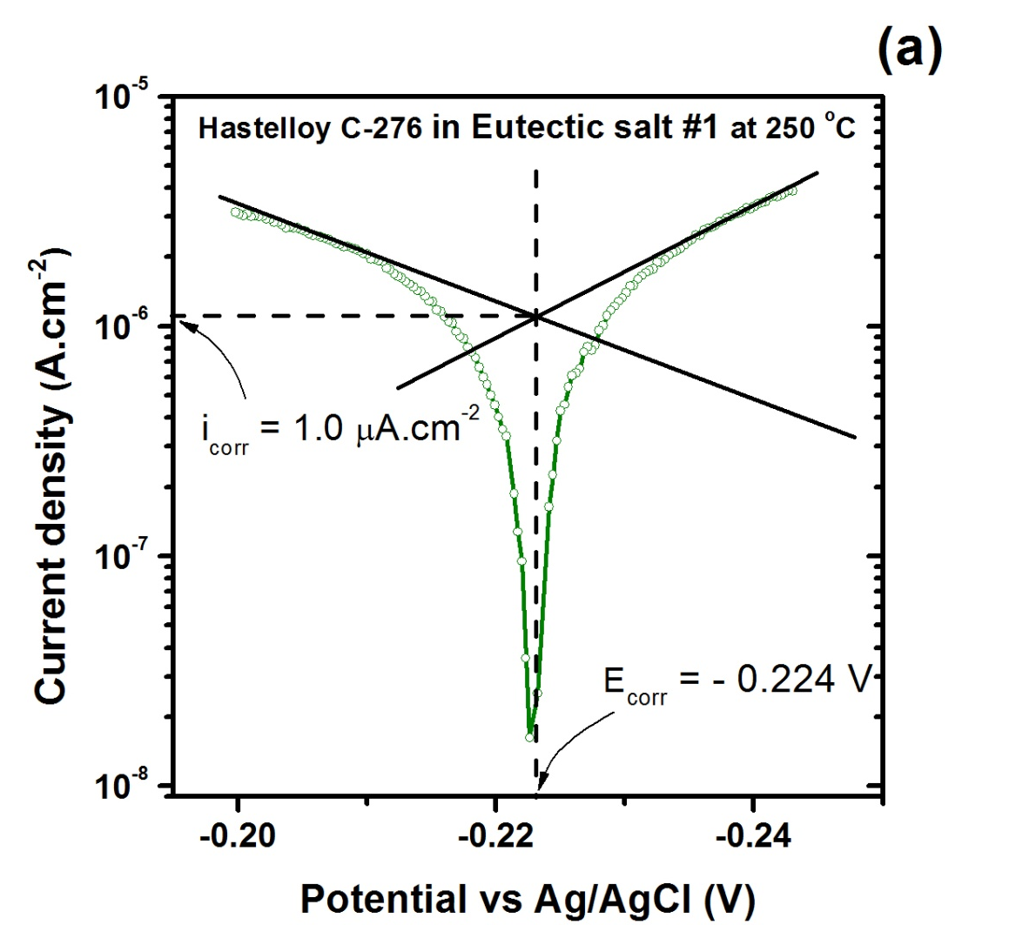
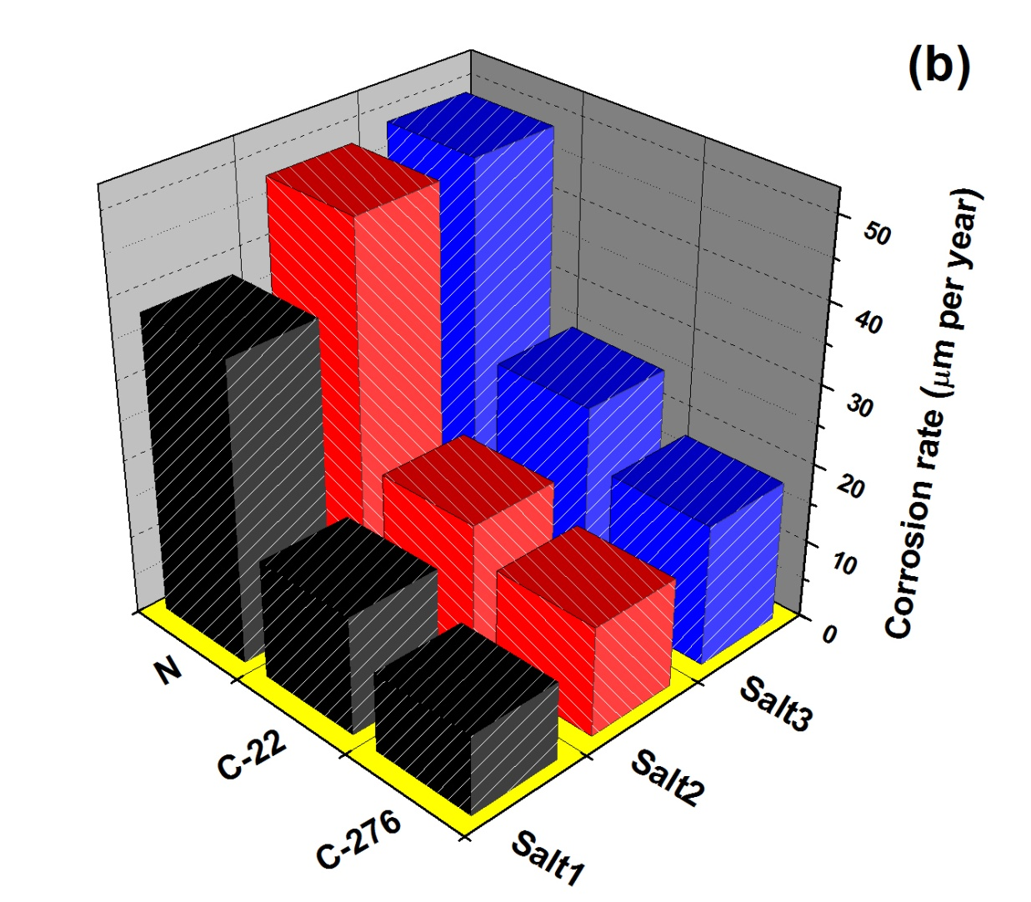
Results from Tafel Technique
CR (µm/year) = K₁ [i_{corr}.EW/ρ]
K₁= known constant, EW= equivalent weight of metal, ρ= density of metal

Slide 14
Findings
Corrosion of Hastelloy C-276 at 250 ºC is ~10 µm/yr
Increases as temperature goes up
Due to Chlorine being more activated
Corrosion at 500 ºC is ~40 µm/yr
Corrosion at 800 ºC is over µm/yr
Nitrates under 10 µm/yr, need to replace nitrates
Need to reduce in order to be commercially feasible!

Slide 15
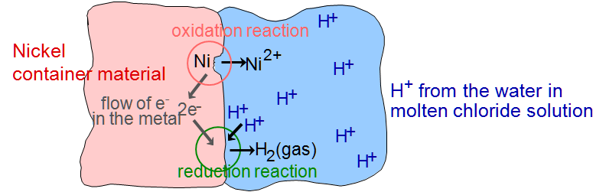
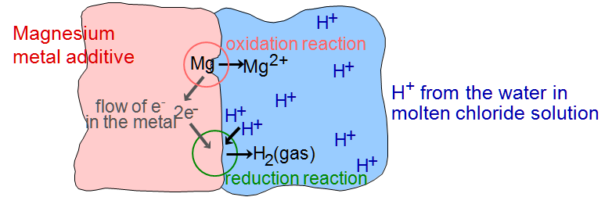
Corrosion Inhibitors
Nickel is ionized by Chloride and an oxidation/reduction reaction occurs spontaneously, corroding the metal
With an additive, the sacrificial metal is included in the O/R rxn, rather than the piping material

Slide 16
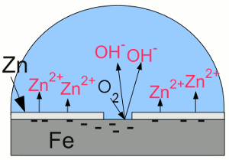
Example of Galvanized Steel
Zinc coating on piping causes a thin oxide layer to form, preventing corrosion
Passivation Layer
Cannot coat piping
Too hot
Additive to salt

Slide 17
Continuing Work
Continue studies of the material in different temperatures/settings
Inert setting/temps up to 1000 ºC
Continue to study additives to reduce corrosion
Test different metals like Mg, Zn, and Al

Slide 18
Questions?

